Slide 1
Data Visualization
——A program that reads a file and draws a Sankey diagram
Rui.Sang
2251576

Slide 2
CONTENTS
The general scheme
&
OOP design
01
02
Diagram
Display Algorithm
03
Diagram
Display Algorithm
04
Additional Features
05
File Handling
06
Exception Handling

Slide 3
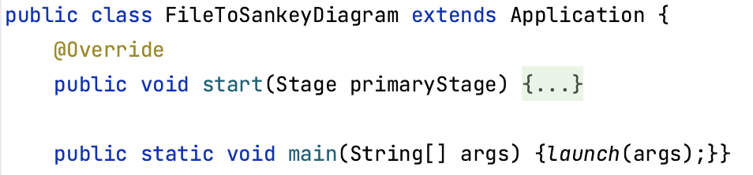
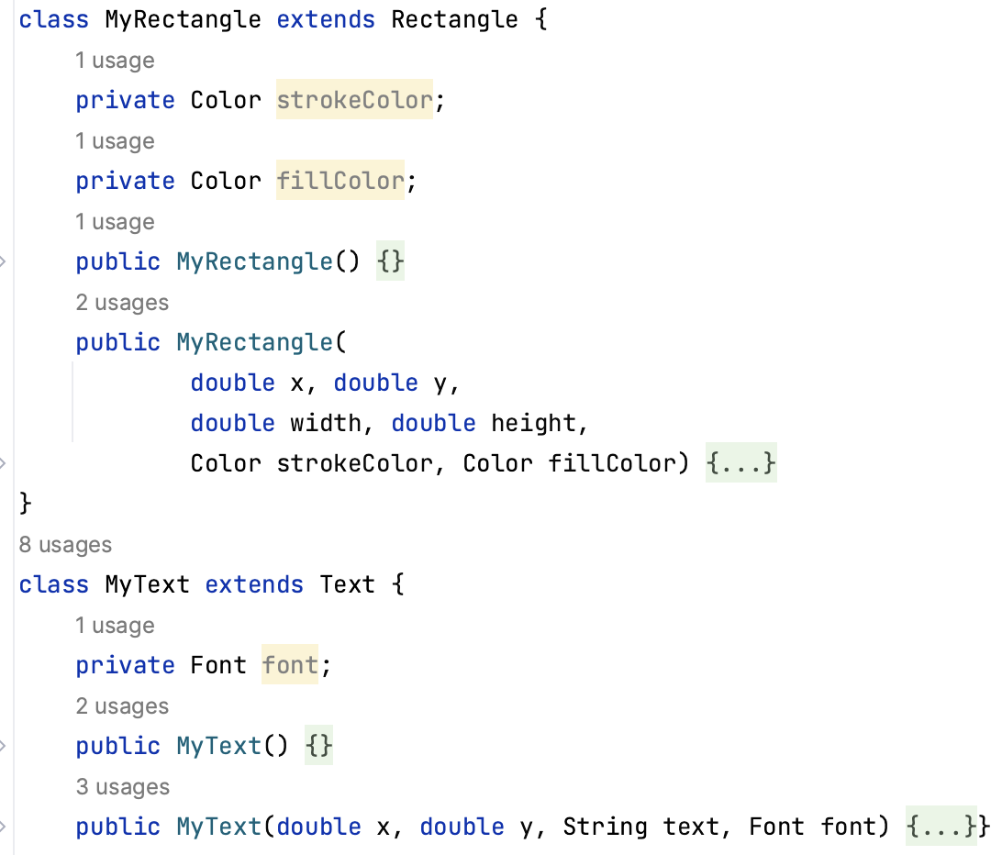
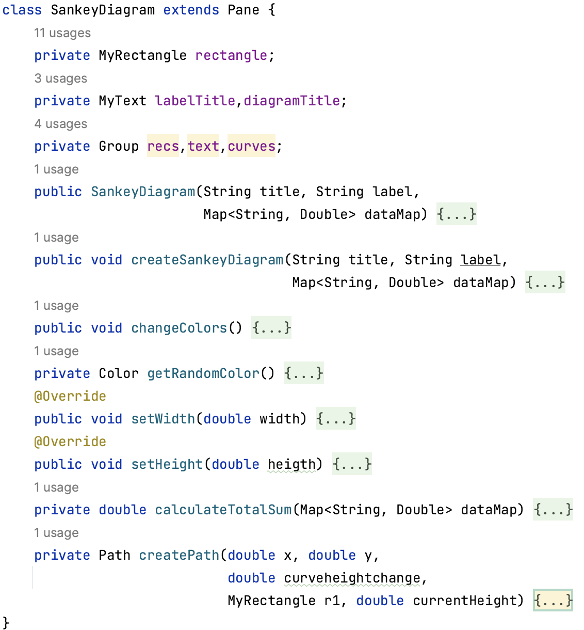
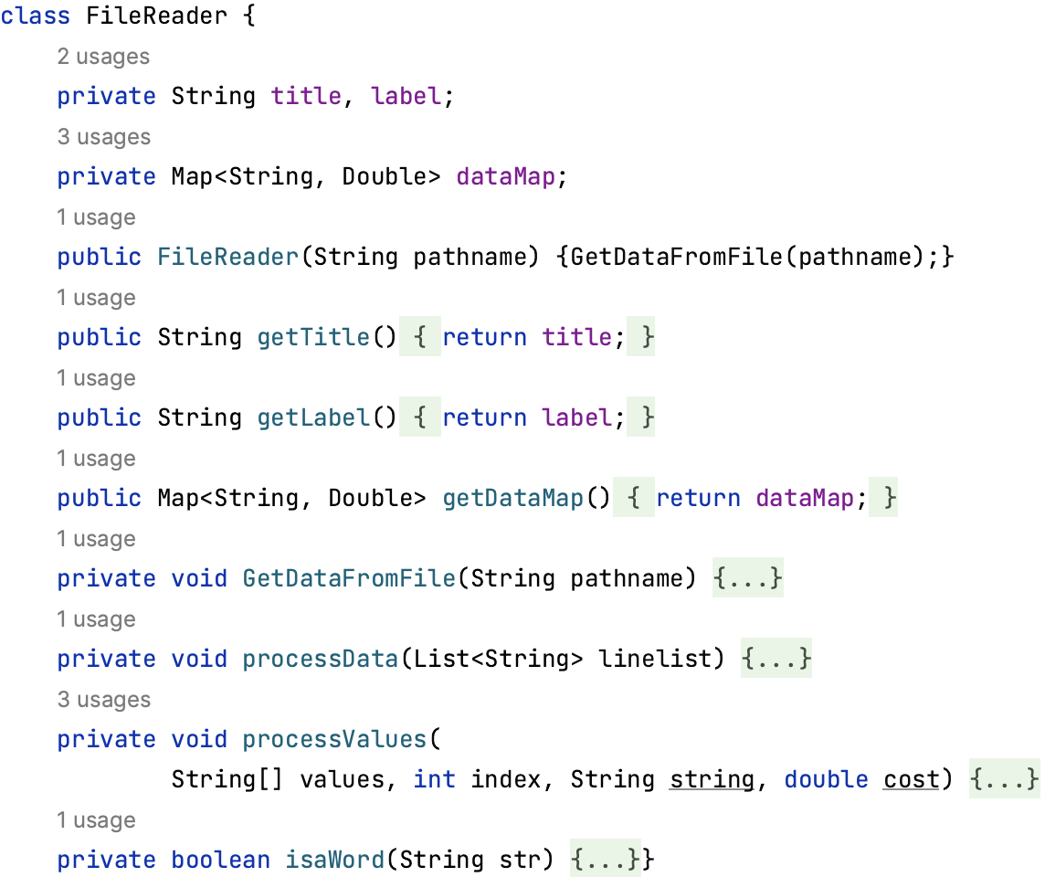
OOP design——Encapsulation&Inheritance&Polymorphis&Abstraction
＊Encapsulation：different classes encapsulate variables and methods—achieve the modularity
＊Inheritance：extend the super class and use the constructer in the supper class—promote code reuse
＊Polymorphism: override the method in super class
＊Abstraction：（detials are in the report）

Slide 4
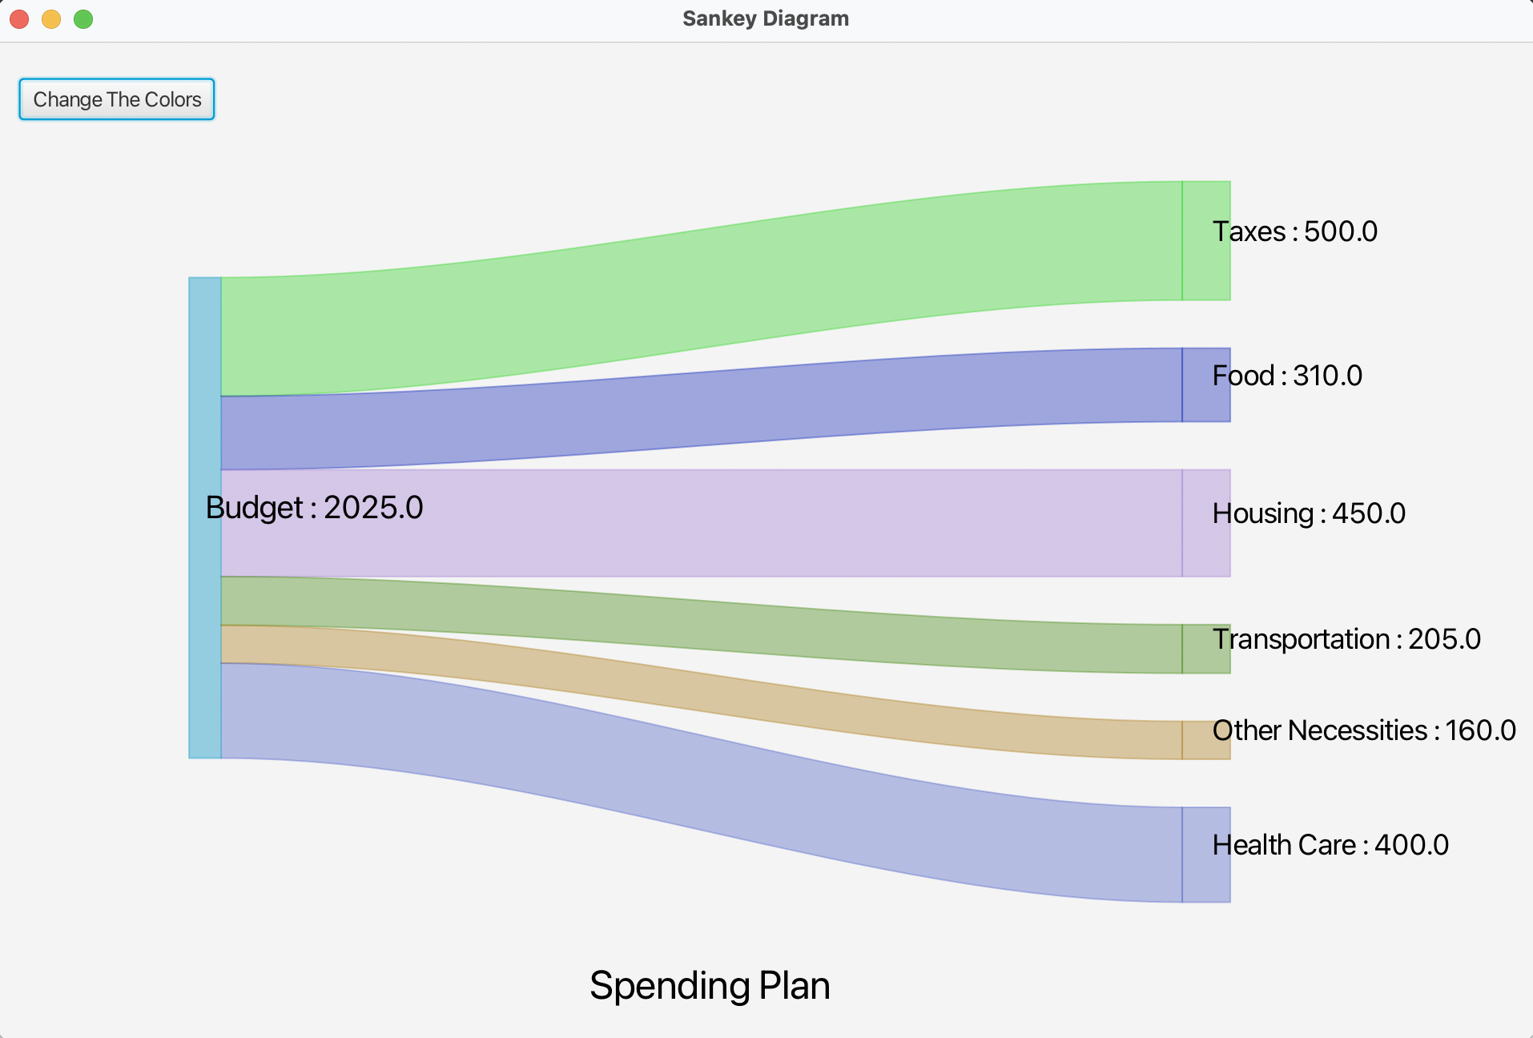
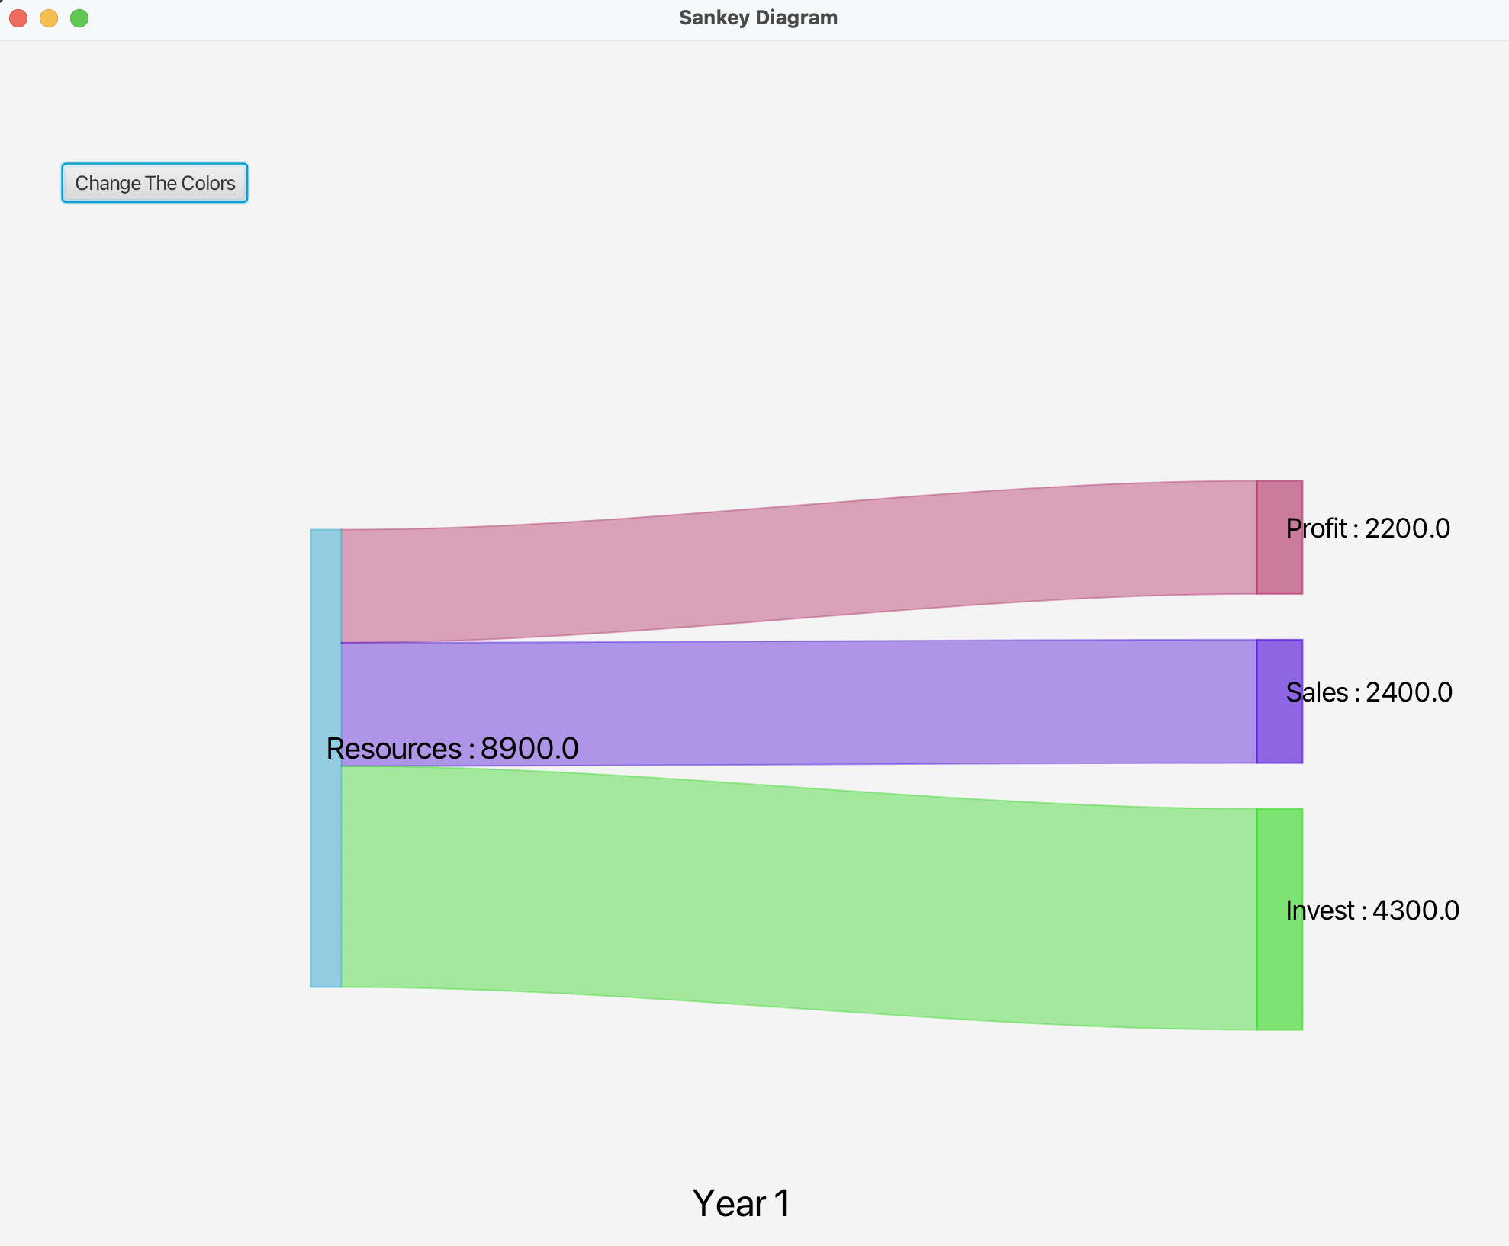
Diagram Display Algorithm——result display
common
short

Slide 5
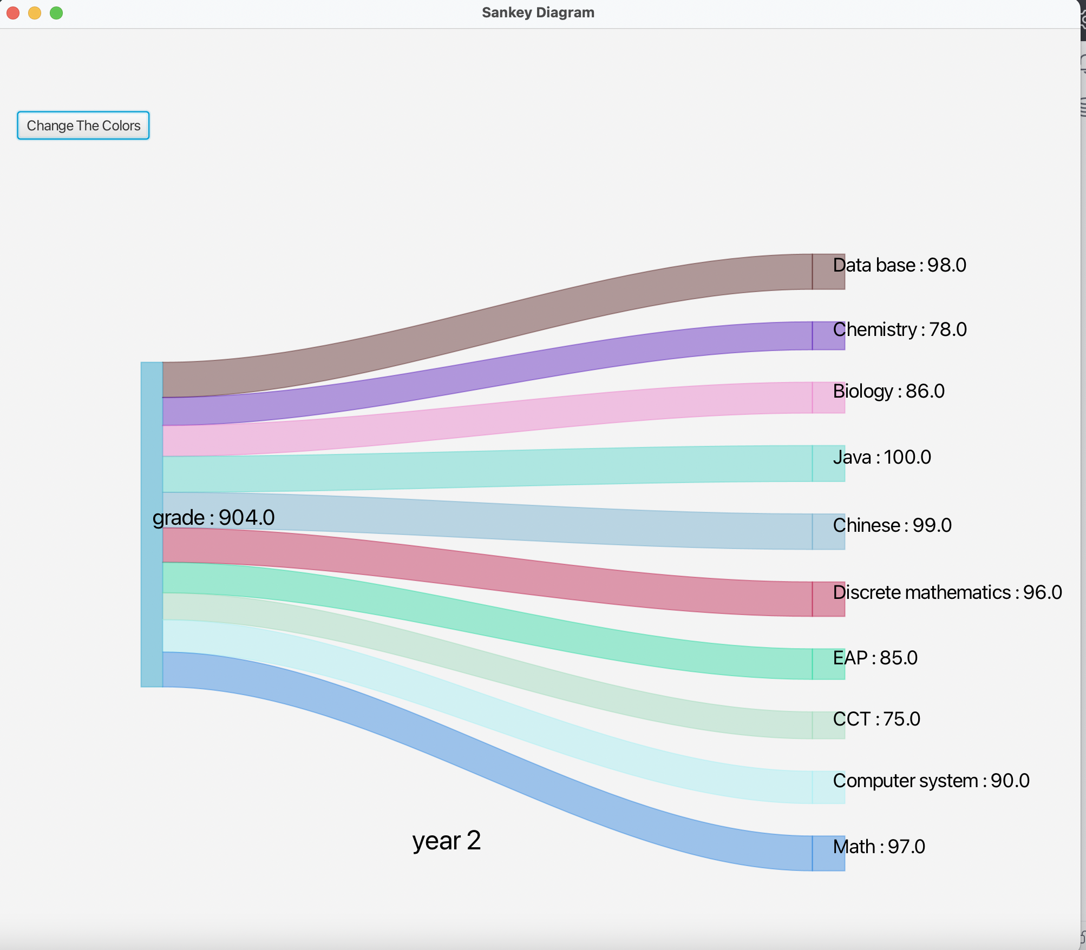
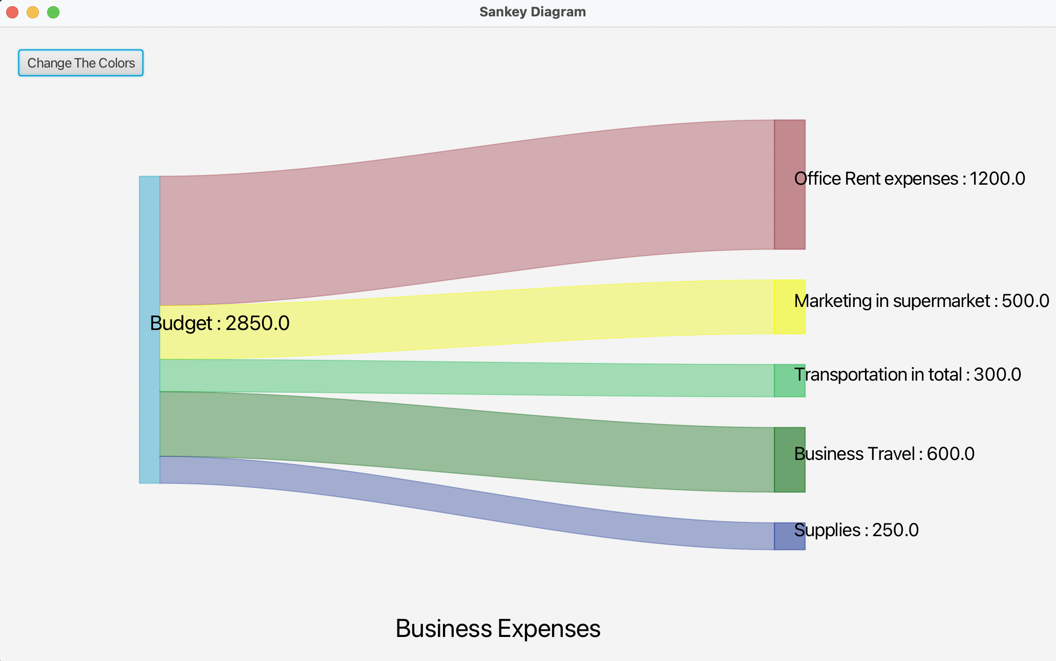
Diagram Display Algorithm——result display
long
complex string

Slide 6
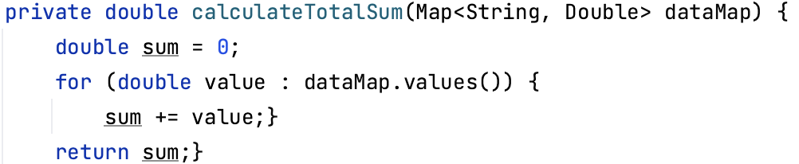
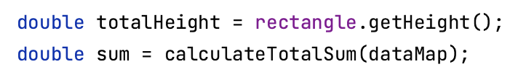
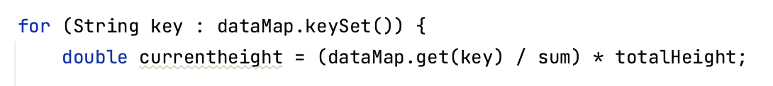
Diagram Display Algorithm——Data Analysis
＊How：HashMap & FOR loop
In the SankeyDiagram class:
In the createSankeyDiagram method (which is In the SankeyDiagram class):
Calculate the sum of the data in the file
The FOR loop is used to accurately pass the data stored in the map to each small rectangle

Slide 7
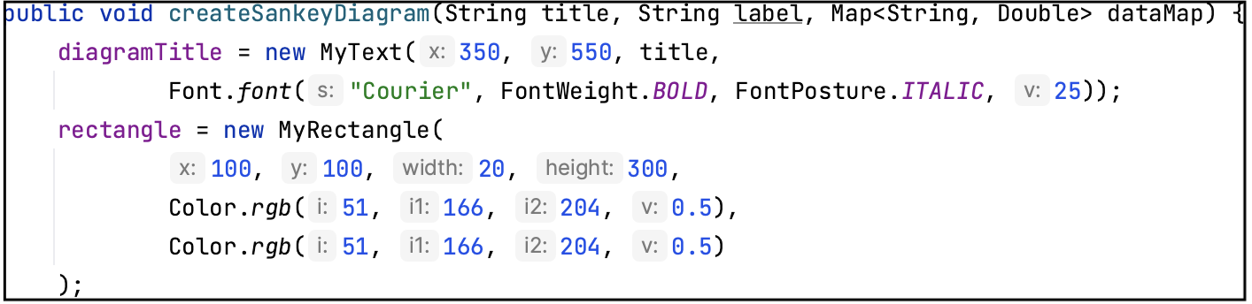
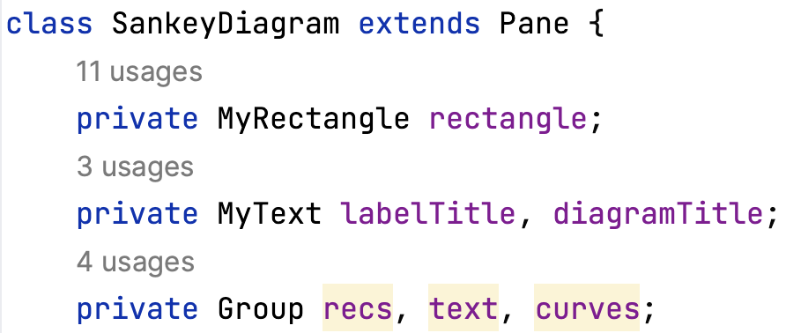
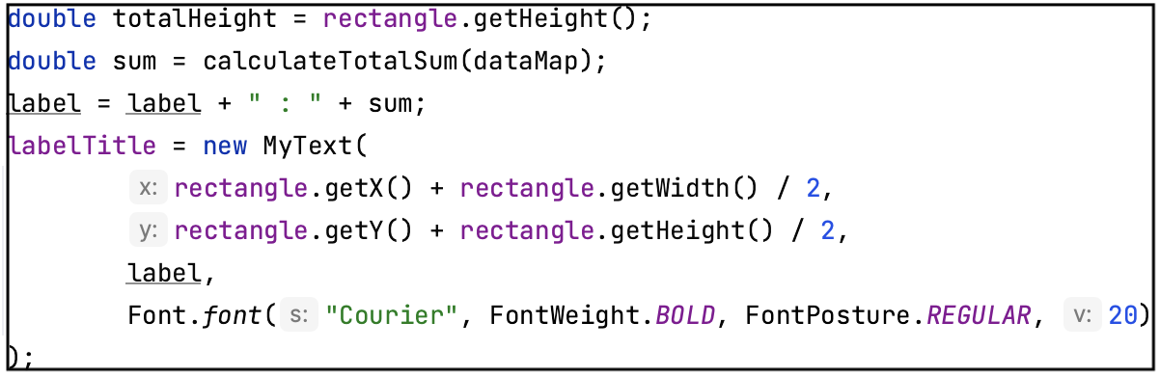
Diagram Display Algorithm——Sankey diagram drawing
......
......
......

Slide 8
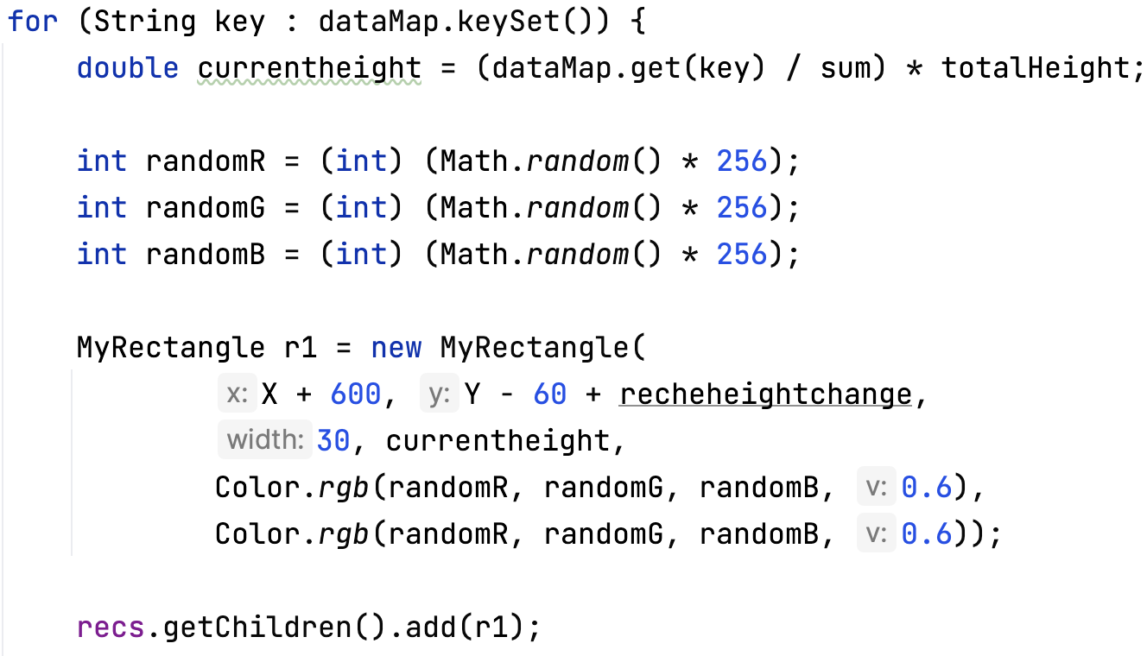
Diagram Display Algorithm——Sankey diagram drawing
......
Call the MyRectangle object to make each small rectangle and add it to the group
......

Slide 9
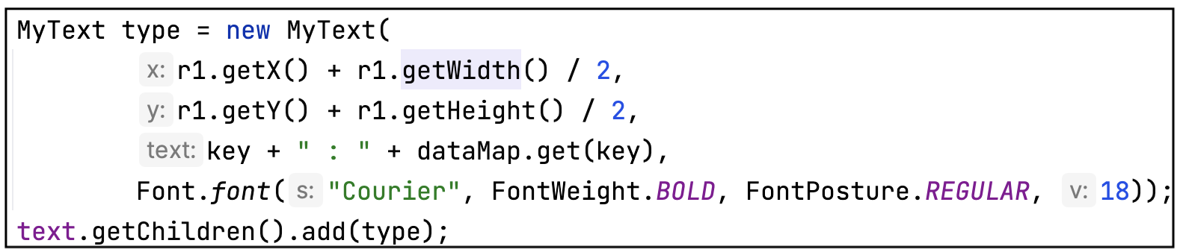
Diagram Display Algorithm——Sankey diagram drawing
The text position is determined by the X and Y values of each small rectangle
......
Call the MyText object to make each corresponding text and add it to the group

Slide 10
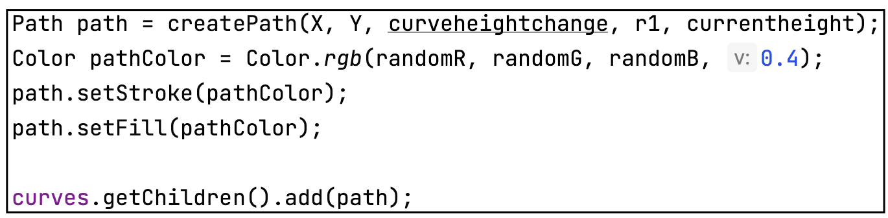
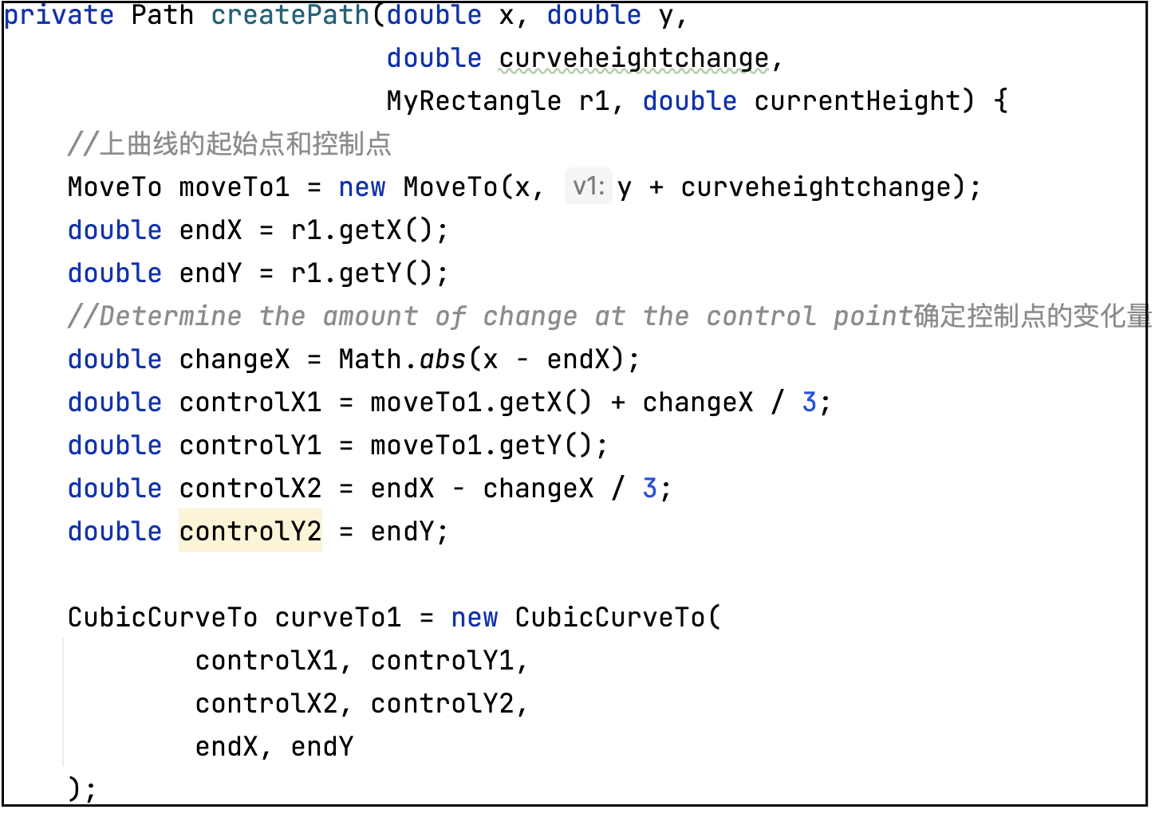
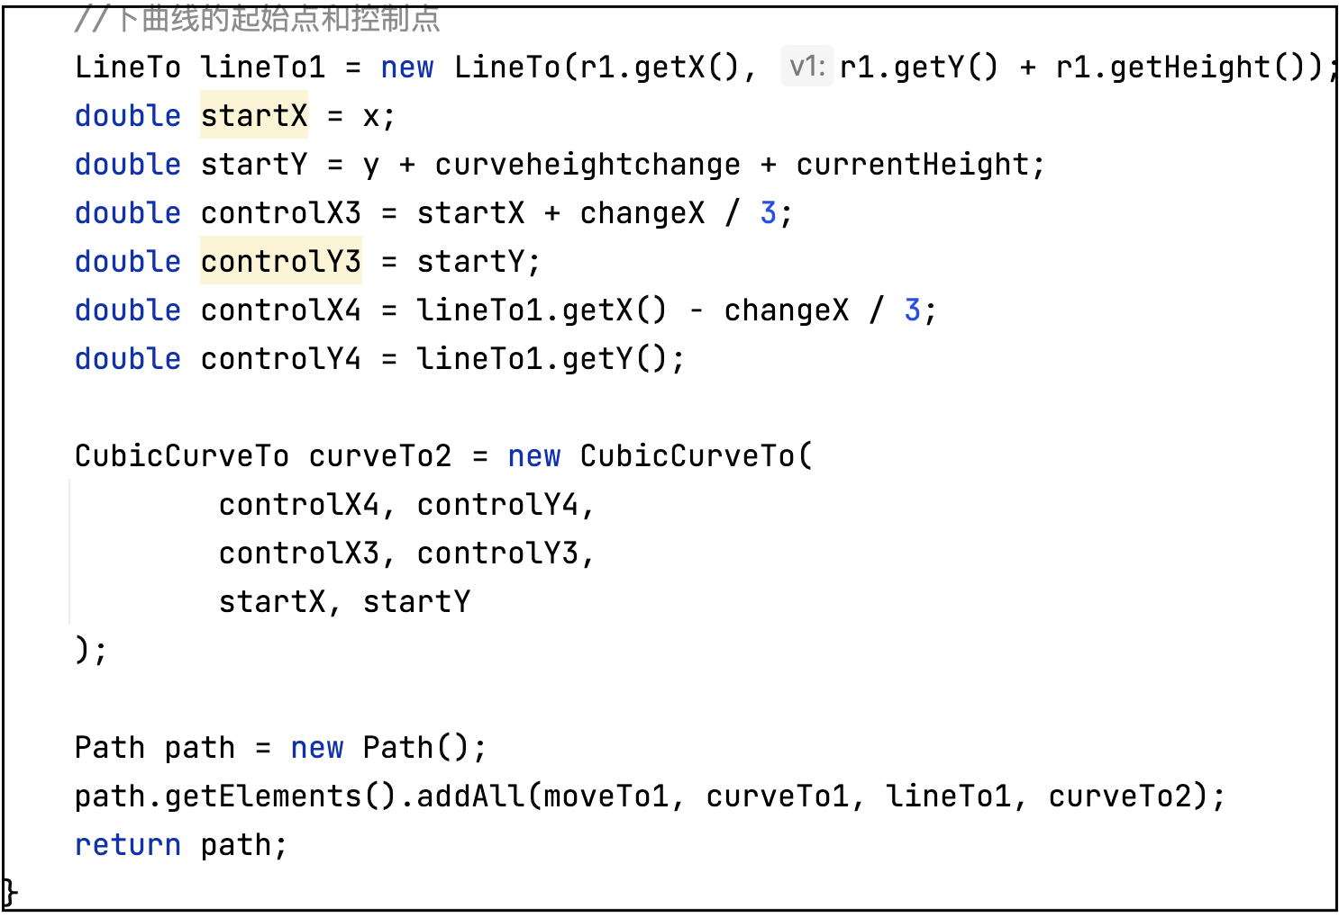
Diagram Display Algorithm——Sankey diagram drawing
......
Call the Path object to make each corresponding curve and add it to the group
The creatPath method creates a path through the upper and lower curves and four control points.

Slide 11
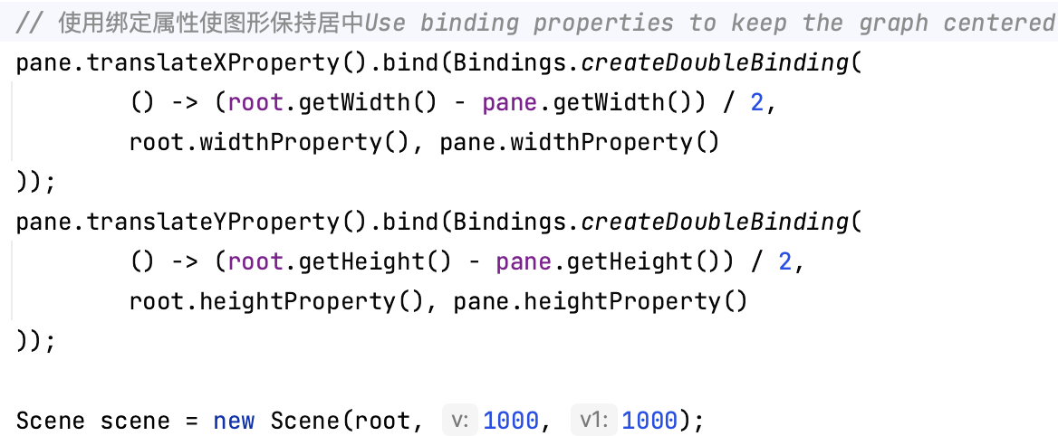
Display while Resizing Algorithm
Main Method：DoubleBinding
The pane displaying the Sankey
width height
The larger pane containing the entire element
width height
......

Slide 12
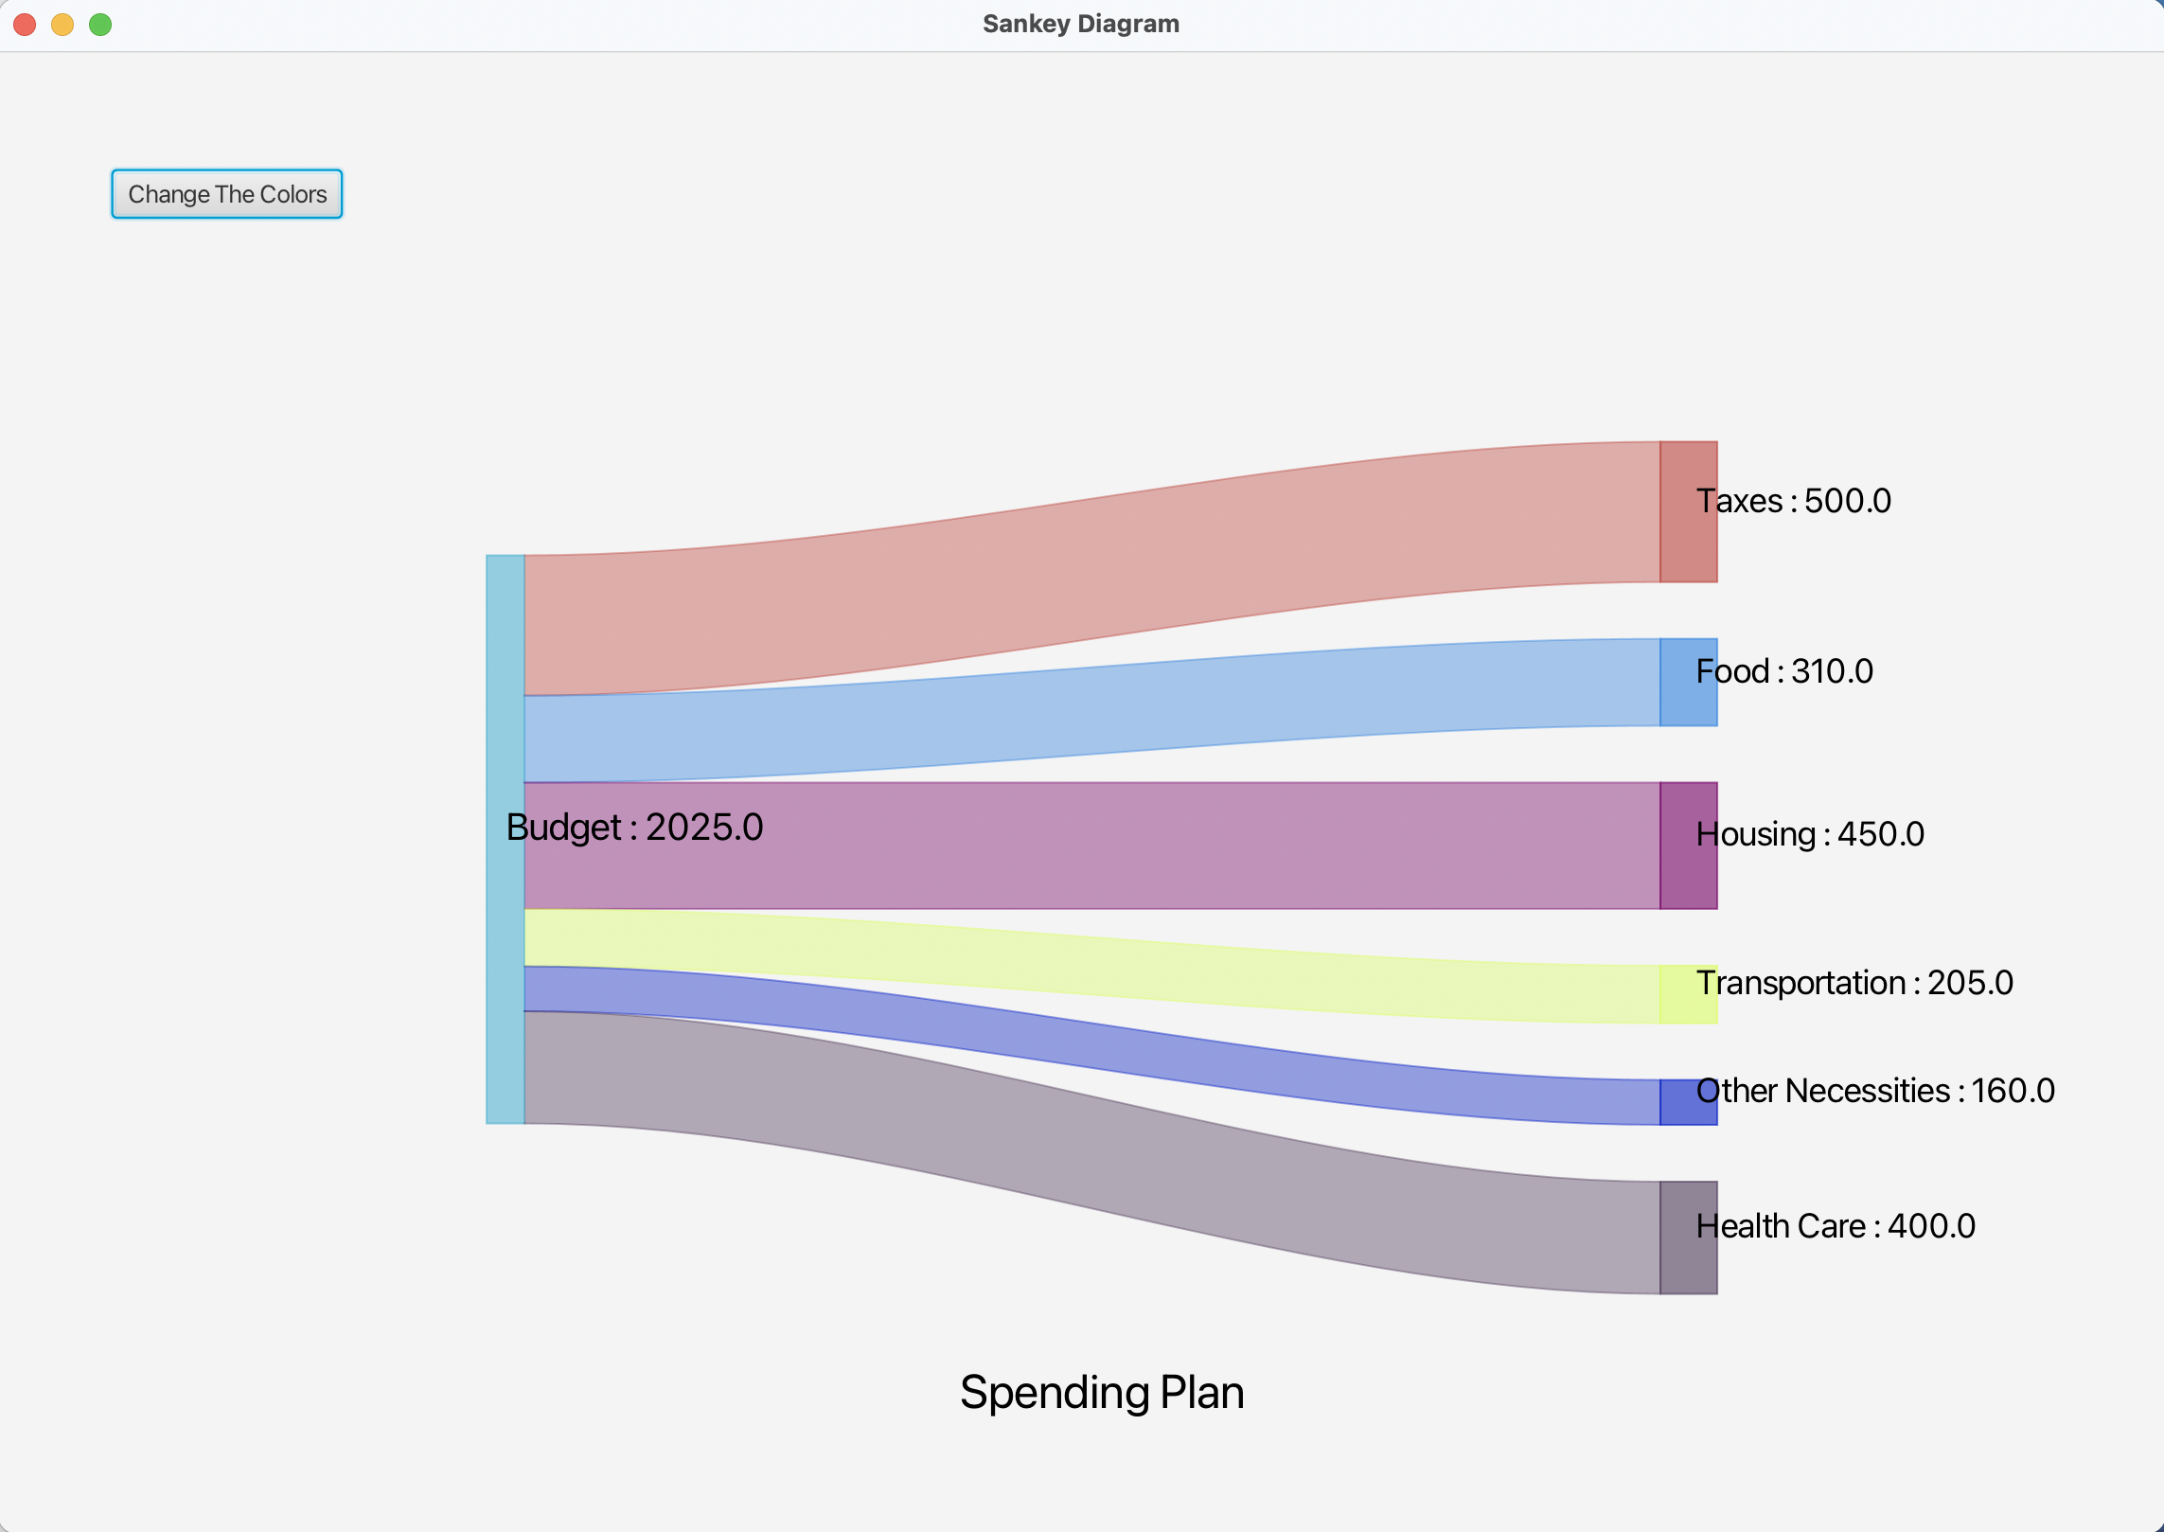
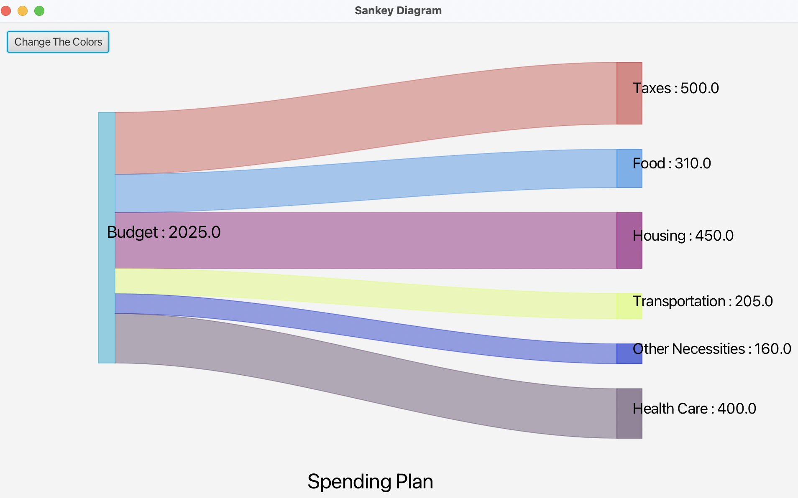
Display while Resizing Algorithm

Slide 13
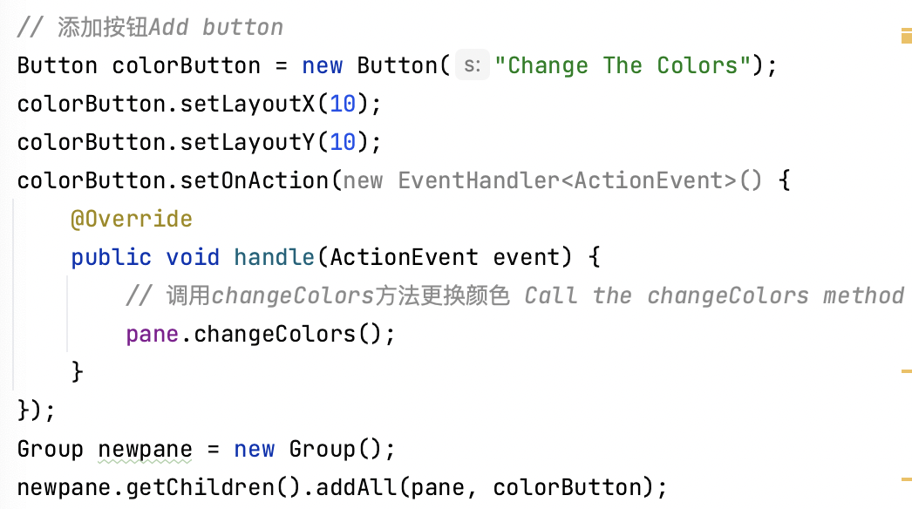
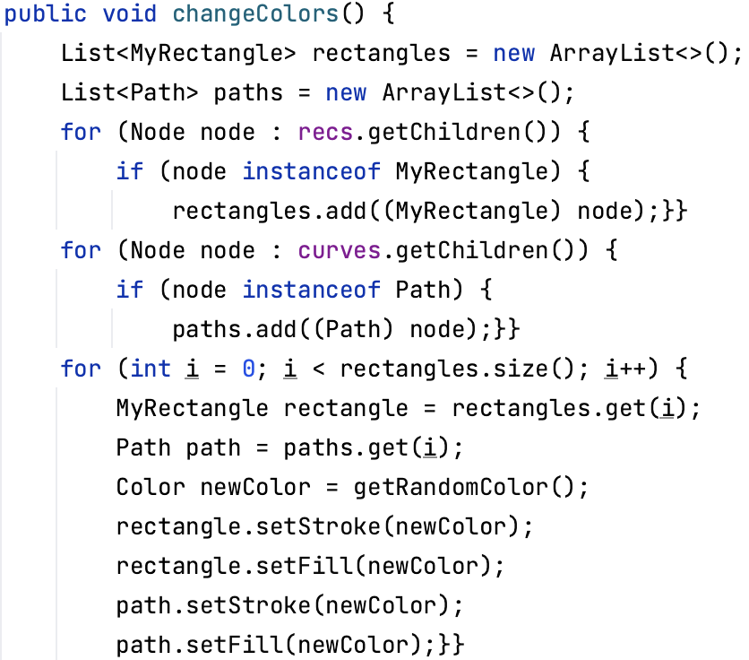
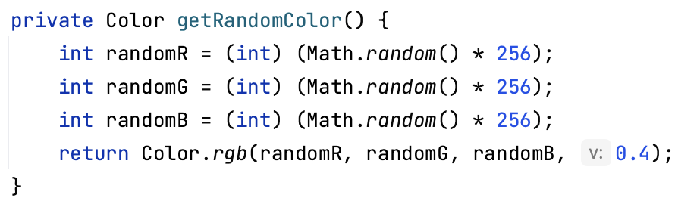
Additional Features—The Color change button
......
......
＊Add buttons and set properties
＊Override and call the method that changes the color
＊Adds to a new pane and joins to the scene
＊Use two for loops to add both the rectangle and path to the new list
＊Use a for loop so that it is added with the newly generated color accordingly
＊A private method that generates random colors

Slide 14
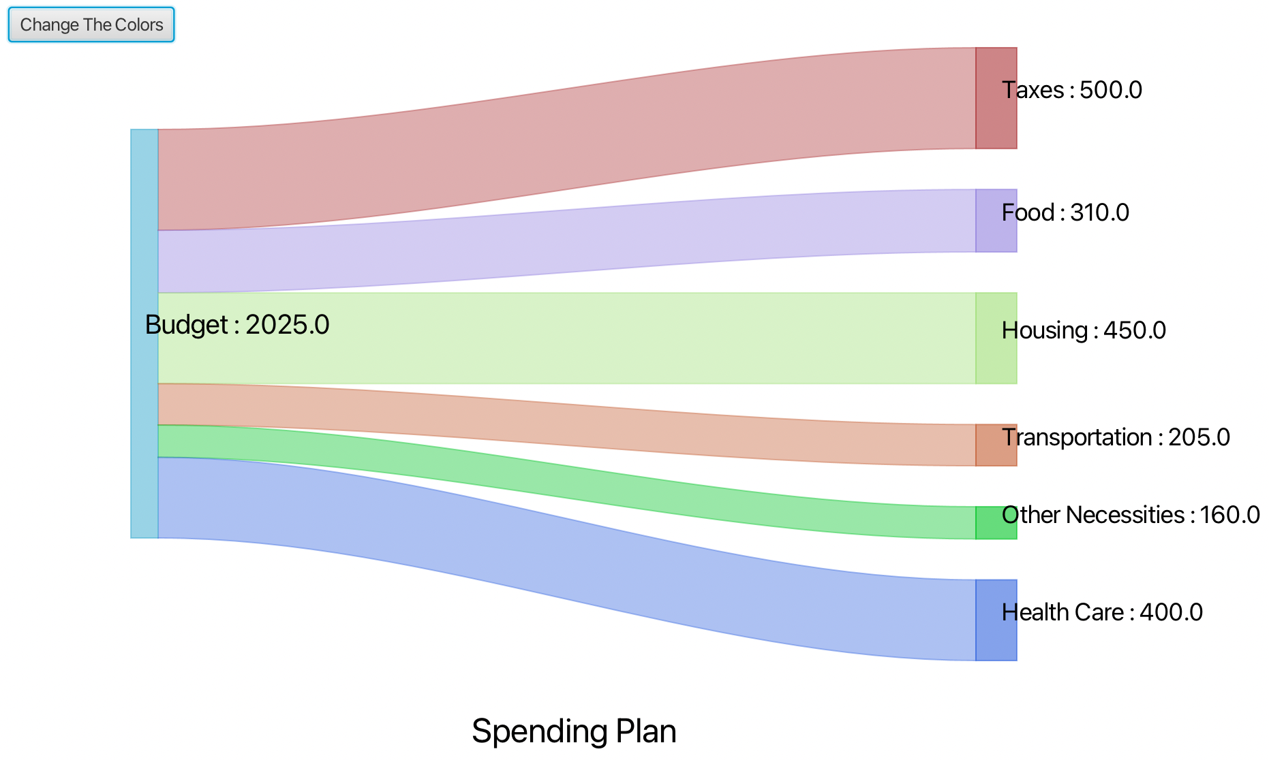
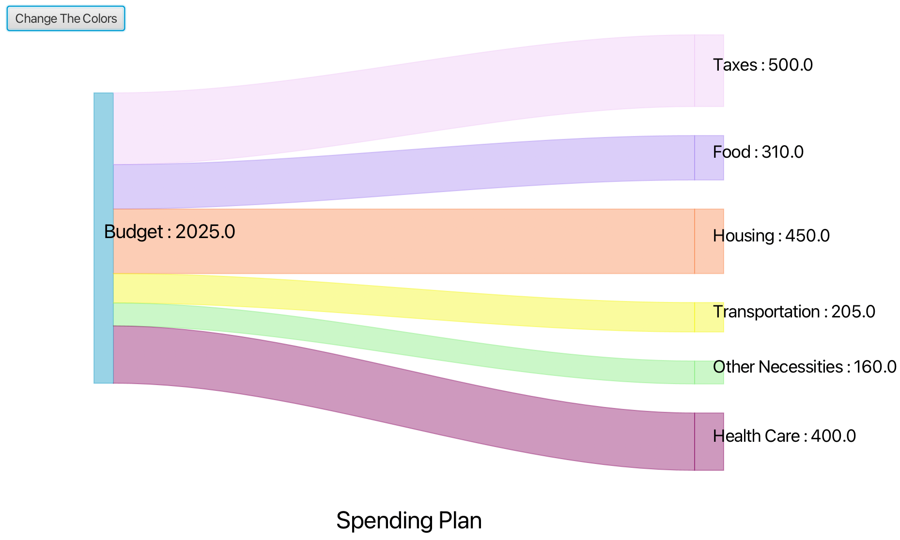
Additional Features—The Color change button

Slide 15
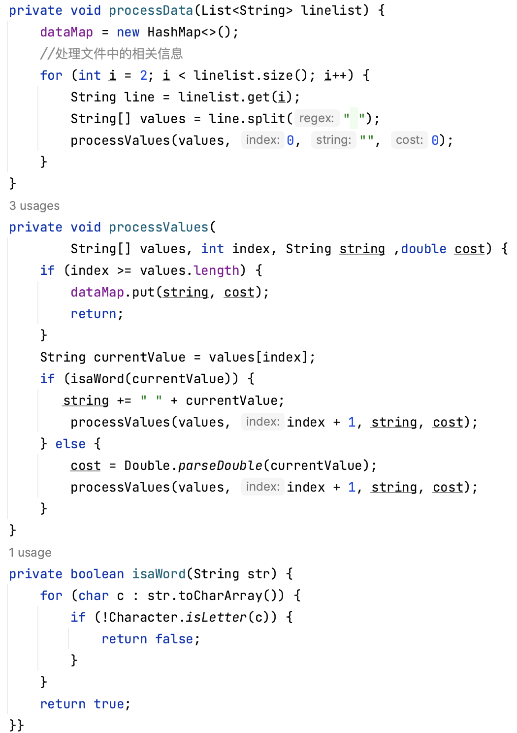
File Handling
Read the file add every lines to a list
Split every lines to a new array
In every array use a method to determine whether an element is a word or a number
then use recursion to get the name of each class and its corresponding data very accurately
＊File Reading：
Put each line into a list
＊Data parsing and Verification

Slide 16
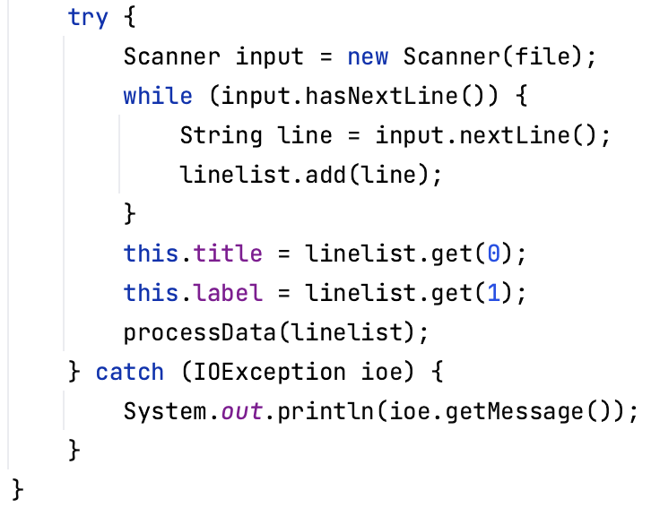
Exception Handling
Type——IOException：
＊May occur during a file input/output operation.
＊In the code, when reading a file through Scanner, we use the Scanner constructor and the nextLine() method, whose calls may throw IOException
Handling Policy：
＊Using a try-catch block
＊First, it tries to run in the try block. If the code in the try block raises IOException, it jumps to the catch block. The exception message for the caught IOException is printed with System.out.println(ioe.getMessage())
......

Slide 17
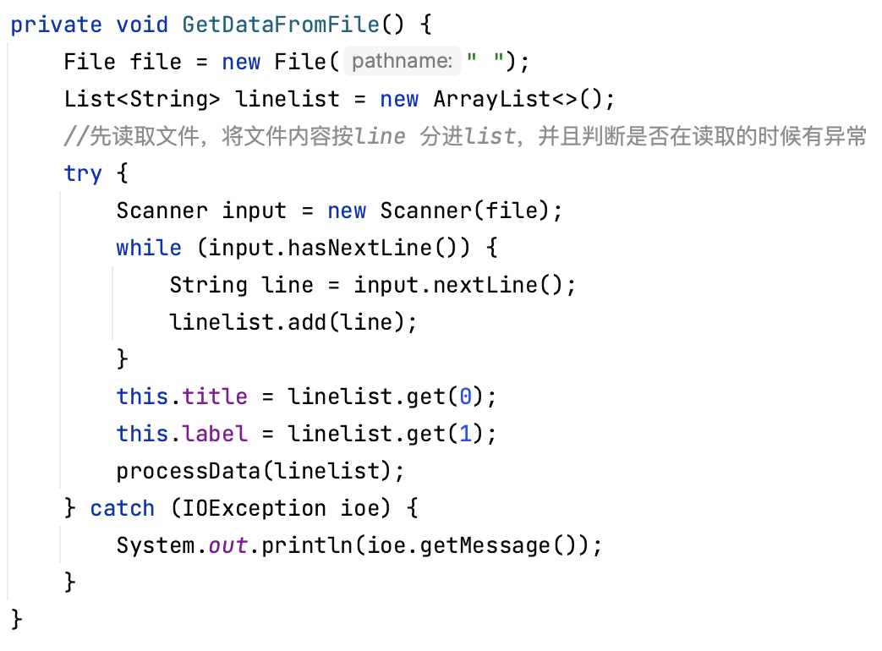
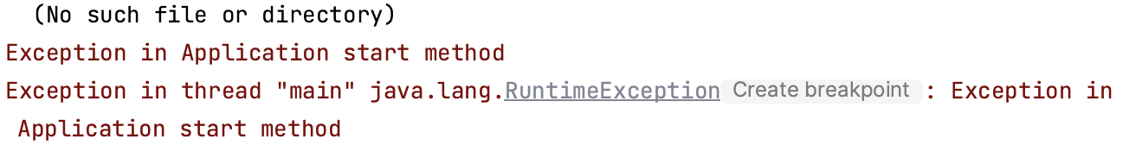
Exception Handling
......

Slide 18
The end
Thank you and Happy New Year!!

